Slide 1
THE AMIDAH
THE PROTOCOL OF OUR KING

Slide 2
Proverbs 18:13 He who gives answer before he hears, that is folly and shame to him.

Slide 3
QUESTION:
1. WHEN YESHUA COMES RIDING ON THE CLOUDS WOULD YOU KNOW THE PROTOCOL OF HOW TO RENDER HONOR TO YOUR FUTURE KING.
2. DO YOU KNOW HOW TO HONOR THE FATHER YHVH OUR KING RIGHT NOW.

Slide 4
THE AMIDAH
The Standing Prayer teaches us the protocol of our King

Slide 5
KAVANAH
PRAYER WITHOUT INTENTION AND CONCENTRATION IS LIKE A BODY WITH OUT A SOUL (NESHAMA)

Slide 6
Numbers 28:
1 ¶ And the LORD spake unto Moses, saying,
2 Command the children of Israel, and say unto them, My offering, and my bread for my sacrifices made by fire, for a sweet savour unto me, shall ye observe to offer unto me in their due season.
3 And thou shalt say unto them, This is the offering made by fire which ye shall offer unto the LORD; two lambs of the first year without spot day by day, for a continual burnt offering.
4 The one lamb shalt thou offer in the morning, and the other lamb shalt thou offer at even;

Slide 7
04150. dewm mow`ed, mo-ade'
Search for 04150 in KJV
or moled {mo-ade'}; or (feminine) moweadah (2 Chronicles 8:13) {mo-aw-daw'}; from 3259; properly, an appointment, i.e. a fixed time or season; specifically, a festival; conventionally a year; by implication, an assembly (as convened for a definite purpose); technically the congregation; by extension, the place of meeting; also a signal (as appointed beforehand):--appointed (sign, time), (place of, solemn) assembly, congregation, (set, solemn) feast, (appointed, due) season, solemn(-ity), synogogue, (set) time (appointed).
See Hebrew 03259 (ya`ad)

Slide 8
03259. dey ya`ad, yaw-ad'
Search for 03259 in KJV
a primitive root; to fix upon (by agreement or appointment); by implication, to meet (at a stated time), to summon (to trial), to direct (in a certain quarter or position), to engage (for marriage): -agree,(maxke an) appoint(-ment,a time), assemble (selves), betroth, gather (selves, together), meet (together), set (a time).

Slide 9
TEFILLAH = PRAYER
JUDAISM TEACHES IN THE SYNOGOGUE SERVICE THE PROTOCOL OF HOW TO APPROACH OUR KING.

Slide 10
Western Christians all too often have the attitude of Elohim as “Elohim is my buddy” mentality.
Yes, He is our great Friend, but He is also our King, the Holy One, and we must treat Him with the proper respect.

Slide 11
Incense as Prayer
Psalms 141:1
<<A Psalm by David.>> LORD, I have called on you. Come to me quickly! Listen to my voice when I call to you.
Psa 141:2
Let my prayer be set before you like incense; the lifting up of my hands like the evening sacrifice.

Slide 12
Exodus 30:34
The LORD said to Moshe, "Take to yourself sweet spices, gum resin, and onycha, and galbanum; sweet spices with pure frankincense: of each shall there be an equal weight;
Exodus 30:35
and you shall make incense of it, a perfume after the art of the perfumer, seasoned with salt, pure and holy:

Slide 13
The Temple - Its Ministry and Service
by
Alfred Edersheim, D. D., Ph. D.
Chapter 8

Slide 14
The incense burned upon this altar was prepared of the four ingredients mentioned in Exo_30:34, with which, according to the Rabbis, seven others were mixed, besides a small quantity of 'Ambra,' and of a herb which gave out a dense smoke. To these thirteen substances (Jos. Wars, v. 5. s.) salt was of course added. The mode of preparing the incense had been preserved in the family of Abtinas. The greatest care was taken to have the incense thoroughly bruised and mixed. Altogether 368 pounds were made for the year's consumption, about half a pound being used every morning and evening in the service. The censer for the Day of Atonement was different in size and appearance from that for ordinary days.

Slide 15
The Lot for Incense
After this the lot was cast for burning the incense. No one might take part in it who had ministered in that office before, unless in the very rare case that all present had previously so officiated. Hence, while the other three lots held good for the evening service, that for the incense required to be repeated. He on whom this lot fell chose from among his friends his two assistants. Finally, the third was succeeded by the fourth lot, which designated those who were to lay on the altar the sacrifice and the meat-offerings, and to pour out the drink-offering.

Slide 16
Offering the Incense
The incensing priest and his assistance now approached first the altar of burnt-offering. One filled with incense a golden censer held in a silver vessel, while another placed in a golden bowl burning coals from the altar. As they passed from the court into the Holy Place, they struck a large instrument (called the 'Magrephah'), at sound of which the priests hastened from all parts to worship, and the Levites to occupy their places in the service of song; while the chief of the 'stationary men' ranged at the Gate of Nicanor such of the people as were to be purified that day. Slowly the incensing priest and his assistants ascended the steps to the Holy Place, preceded by the two priests who had formerly dressed the altar and the candlestick, and who now removed the vessels they had left behind, and, worshipping, withdrew. Next, one of the assistants reverently spread the coals on the golden altar; the other arranged the incense; and then the chief officiating priest was left alone within the Holy Place, to await the signal of the president before burning the incense. It was probably while thus expectant that the angel Gabriel appeared to Zacharias. As the president gave the word of command, which marked that 'the time of incense had come,' 'the whole multitude of the people without' withdrew from the inner court, and fell down before the Lord, spreading their hands * in silent prayer.

Slide 17
ORTHODOX PRAYERS ON YOM TERUAH & YOM KIPPUR
MESSIAH IN THE MACHZOR OF THE FEAST

Slide 18
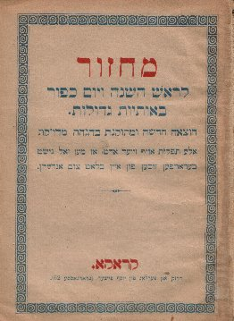
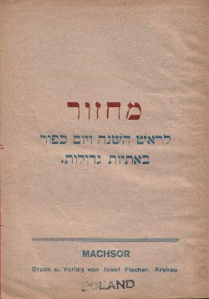
This Orthodox Machzor (Prayer Book) is from Krakau, Poland of unknown date (possibly late 19th century)

Slide 19
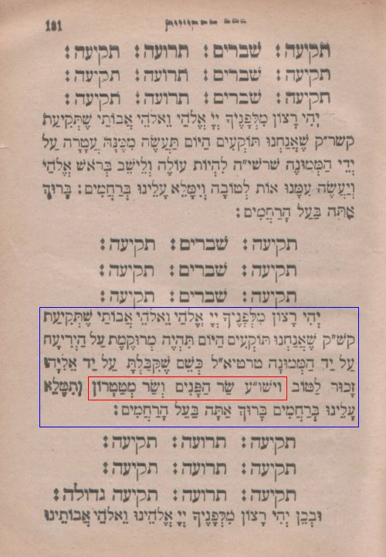

Slide 21
The Importance of the Hebrew Language in your prayers

Slide 22
Zephaniah 3:9
For then will I turn to the people a PURE LANGUAGE, that they may all call upon the name of YHVH, to serve Him with one consent. {language: Heb. lip}{consent:Heb.shoulder}

Slide 23
Modern Hebrew
19th century to present
Eliezar Ben Yehuda (1858-1922) led the rebirth of Hebrew as a spoken language. After immigrating to Israel in 1881, he began promoting the use of Hebrew at home and in the schools.

Slide 24
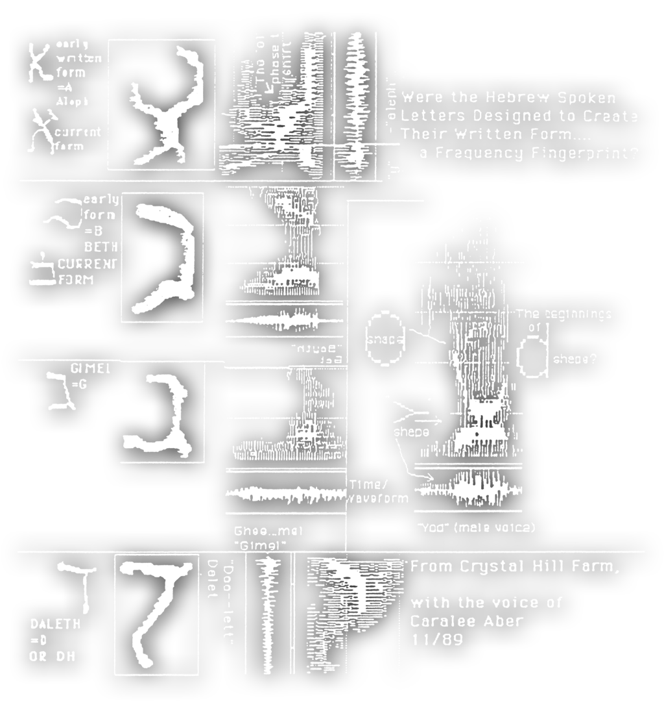

Slide 25
BIBLICAL PRAYERS 1. Moses 2. Solomon 3. Nehemiah 4. Daniel 5. Hannah 6. Yeshua

Slide 26
Moses

Slide 27
Exodus 33:
11 Thus the LORD used to speak to Moses face to face, as a man speaks to his friend. When Moses turned again into the camp, his servant Joshua the son of Nun, a young man, did not depart from the tent.
12 ¶ Moses said to the LORD, "See, thou sayest to me, 'Bring up this people'; but thou hast not let me know whom thou wilt send with me. Yet thou hast said, 'I know you by name, and you have also found favor in my sight.'
13 Now therefore, I pray thee, if I have found favor in thy sight, show me now thy ways, that I may know thee and find favor in thy sight. Consider too that this nation is thy people."

Slide 28
Exodus 33:
14 And he said, "My presence will go with you, and I will give you rest."
15 And he said to him, "If thy presence will not go with me, do not carry us up from here.
16 For how shall it be known that I have found favor in thy sight, I and thy people? Is it not in thy going with us, so that we are distinct, I and thy people, from all other people that are upon the face of the earth?"
17 And the LORD said to Moses, "This very thing that you have spoken I will do; for you have found favor in my sight, and I know you by name."

Slide 29
Exodus 33:1
8 Moses said, "I pray thee, show me thy glory."
19 And he said, "I will make all my goodness pass before you, and will proclaim before you my name 'The LORD'; and I will be gracious to whom I will be gracious, and will show mercy on whom I will show mercy.

Slide 30
The Pattern Of Prayer
How do we know how to pray?
Has YHVH given us a clear understanding as to how He wants to be worshipped? Lets take a look at what the Tanakh says about the Temple service:

Slide 31
2 Chronicles 5
11 ¶ Now when the priests came out of the holy place (for all the priests who were present had sanctified themselves, without regard to their divisions;
12 and all the Levitical singers, Asaph, Heman, and Jeduthun, their sons and kinsmen, arrayed in fine linen, with cymbals, harps, and lyres, stood east of the altar with a hundred and twenty priests who were trumpeters;

Slide 32
2Ch 5:
13 indeed it came to pass, when the trumpeters and singers were as one, to make one sound to be heard in praising and thanking the LORD, and when they lifted up their voice with the trumpets and cymbals and instruments of music, and praised the LORD, saying: "For He is good, For His mercy endures forever," that the house, the house of the LORD, was filled with a cloud,
14 so that the priests could not continue ministering because of the cloud; for the glory of the LORD filled the house of God.

Slide 33
In the Temple the people never responded to the prayers by an Amen, but always with this benediction, 'Blessed be the name of the glory of His kingdom for ever!‘
Reference from Alfred Adershiem book the Temple

Slide 34
SOLOMON

Slide 35
2Ch 6:
12 ¶ Then Solomon stood before the altar of the LORD in the presence of all the assembly of Israel, and spread out his hands
13 (for Solomon had made a bronze platform five cubits long, five cubits wide, and three cubits high, and had set it in the midst of the court; and he stood on it, knelt down on his knees before all the assembly of Israel, and spread out his hands toward heaven);
14 and he said: "LORD God of Israel, there is no God in heaven or on earth like You, who keep Your covenant and mercy with Your servants who walk before You with all their hearts.

Slide 36
2Chronicles 6:
15 who hast kept with thy servant David my father that which thou didst promise him: yea, thou spakest with thy mouth, and hast fulfilled it with thy hand, as it is this day.
16 Now therefore, O YHVH, the God of Israel, keep with thy servant David my father that which thou hast promised him, saying, There shall not fail thee a man in my sight to sit on the throne of Israel, if only thy children take heed to their way, to walk in my law as thou hast walked before me.

Slide 37
2Ch 6:
17 "And now, O LORD God of Israel, let Your word come true, which You have spoken to Your servant David.
18 "But will God indeed dwell with men on the earth? Behold, heaven and the heaven of heavens cannot contain You. How much less this temple which I have built!
19 "Yet regard the prayer of Your servant and his supplication, O LORD my God, and listen to the cry and the prayer which Your servant is praying before You:
20 "that Your eyes may be open toward this temple day and night, toward the place where You said You would put Your name, that You may hear the prayer which Your servant prays toward this place.
21 "And may You hear the supplications of Your servant and of Your people Israel, when they pray toward this place. Hear from heaven Your dwelling place, and when You hear, forgive.

Slide 38
Nehemiah

Slide 39
Nehemiah 1:
4 And it came to pass, when I heard these words, that I sat down and wept, and mourned certain days; and I fasted and prayed before the Elohim of heaven,
5 and said, I beseech thee, O YHVH, the Elohim of heaven, the great and terrible Elohim, that keepeth covenant and loving kindness with them that love him and keep his commandments:
6 Let thine ear now be attentive, and thine eyes open, that thou mayest hearken unto the prayer of thy servant, which I pray before thee at this time, day and night, for the children of Israel thy servants while I confess the sins of the children of Israel, which we have sinned against thee. Yea, I and my father's house have sinned:

Slide 40
7 we have dealt very corruptly against thee, and have not kept the commandments, nor the statutes, nor the ordinances, which thou commanded thy servant Moses.
8 Remember, I beseech thee, the word that thou commanded thy servant Moses, saying, If ye trespass, I will scatter you abroad among the peoples:
9 but if ye return unto me, and keep my commandments and do them, though your outcasts were in the uttermost part of the heavens, yet will I gather them from thence, and will bring them unto the place that I have chosen, to cause my name to dwell there.

Slide 41
10 Now these are thy servants and thy people, whom thou hast redeemed by thy great power, and by thy strong hand.
11 O Adonai, I beseech thee, let now thine ear be attentive to the prayer of thy servant, and to the prayer of thy servants, who delight to fear thy name; and prosper, I pray thee, thy servant this day, and grant him mercy in the sight of this man. Now I was cupbearer to the king.

Slide 42
The Temple and prayers
Nehemiah 11:17
and Mattanyah the son of Mikha, the son of Zavdi, the son of Asaf, who was the chief to begin the thanksgiving in prayer, and Bakbukyah, the second among his brothers; and `Avda the son of Shammua, the son of Galal, the son of Yedutun.

Slide 43
How many times David prayed?

Slide 44
Psalms 55: 16 ¶ As for me, I will call upon God; and the LORD shall save me. 17 Evening, and morning, and at noon, will I pray, and cry aloud: and he shall hear my voice.

Slide 45
Daniel

Slide 46
Daniel 6:10
Now when Daniel knew that the writing was signed, he went into his house; and his windows being open in his chamber toward Jerusalem, he kneeled upon his knees three times a day, and prayed, and gave thanks before his God, as he did aforetime.

Slide 47
Daniel 9:
2 in the first year of his reign I, Daniel, understood by the books the number of the years whereof the word of YHVH came to Jeremiah the prophet, for the accomplishing of the desolations of Jerusalem, even seventy years.
3 And I set my face unto the Adonai Elohim, to seek by prayer and supplications, with fasting and sackcloth and ashes.
4 And I prayed unto YHVH my Elohim, and made confession, and said, Oh, Adonai, the great and dreadful Elohim, who keep covenant and loving kindness with them that love him and keep his commandments,
5 we have sinned, and have dealt perversely, and have done wickedly, and have rebelled, even turning aside from thy precepts and from thine ordinances;

Slide 48
6 neither have we hearkened unto thy servants the prophets, that spake in thy name to our kings, our princes, and our fathers, and to all the people of the land.
7 O Adonai, righteousness belong unto thee, but unto us confusion of face, as at this day; to the men of Judah, and to the inhabitants of Jerusalem, and unto all Israel, that are near, and that are far off, through all the countries whither thou hast driven them, because of their trespass that they have trespassed against thee.
8 O Adonai, to us belongeth confusion of face, to our kings, to our princes, and to our fathers, because we have sinned against thee.

Slide 49
9 To the Adonai our Elohim belong mercies and forgiveness; for we have rebelled against him;
10 neither have we obeyed the voice of YHVH our Elohim, to walk in his laws, which he set before us by his servants the prophets.
11 Yea, all Israel have transgressed thy law, even turning aside, that they should not obey thy voice: therefore hath the curse been poured out upon us, and the oath that is written in the law of Moses the servant of Elohim; for we have sinned against him.
12 And he hath confirmed his words, which he spake against us, and against our judges that judged us, by bringing upon us a great evil; for under the whole heaven hath not been done as hath been done upon Jerusalem.

Slide 50
13 As it is written in the law of Moses, all this evil is come upon us: yet have we not entreated the favor of YHVH our Elohim, that we should turn from our iniquities, and have discernment in thy truth.
14 Therefore hath YHVH watched over the evil, and brought it upon us; for YHVH our Elohim is righteous in all his works which he doeth, and we have not obeyed his voice.
15 And now, O Adonai our Elohim, that hast brought thy people forth out of the land of Egypt with a mighty hand, and hast gotten thee renown, as at this day; we have sinned, we have done wickedly.
16 O Adonai, according to all thy righteousness, let thine anger and thy wrath, I pray thee, be turned away from thy city Jerusalem, thy holy mountain; because for our sins, and for the iniquities of our fathers, Jerusalem and thy people are become a reproach to all that are round about us.

Slide 51
17 Now therefore, O our Elohim, hearken unto the prayer of thy servant, and to his supplications, and cause thy face to shine upon thy sanctuary that is desolate, for the Adonai's sake.
18 O my Elohim, incline thine ear, and hear; open thine eyes, and behold our desolations, and the city which is called by thy name: for we do not present our supplications before thee for our righteousness, but for thy great mercies' sake.
19 O Adonai, hear; O Adonai, forgive; O Adonai, hearken and do; defer not, for thine own sake, O my Elohim, because thy city and thy people are called by thy name.

Slide 52
20 And while I was speaking, and praying, and confessing my sin and the sin of my people Israel, and presenting my supplication before YHVH my Elohim for the holy mountain of my Elohim;
21 yea, while I was speaking in prayer, the man Gabriel, whom I had seen in the vision at the beginning, being caused to fly swiftly, touched me about the time of the evening oblation.

Slide 53
Adonai & Elohim
this too is a plural of majesty. The singular form means “master, owner.” Stresses man’s relationship to Elohim as his master, authority, and provider

Slide 54
Yahweh (YHWH):
Comes from a verb which means “to exist, be.” This, plus its usage, shows that this name stresses Elohim as the independent and self-existent Elohim of revelation and redemption

Slide 55
Hannah

Slide 56
1Samuel 1:
9 ¶ So Hannah rose up after they had eaten in Shiloh, and after they had drunk. Now Eli the priest sat upon a seat by a post of the temple of YHVH.
10 And she was in bitterness of soul, and prayed unto YHVH, and wept sore.
11 And she vowed a vow, and said, O YHVH of hosts, if thou wilt indeed look on the affliction of thine handmaid, and remember me, and not forget thine handmaid, but wilt give unto thine handmaid a man child, then I will give him unto YHVH all the days of his life, and there shall no razor come upon his head.

Slide 57
12 And it came to pass, as she continued praying before YHVH, that Eli marked her mouth.
13 Now Hannah, she spake in her heart; only her lips moved, but her voice was not heard: therefore Eli thought she had been drunken.

Slide 58
Silent Prayer
Judaism uses this example as the reason for doing the Amidah in silent just moving the lips.

Slide 59
James 5:16
Confess your faults one to another, and pray one for another, that ye may be healed. The effectual fervent prayer of a righteous man availeth much.

Slide 60
Amidah = Standing
The name "Amidah," which literally is the Hebrew gerund of "standing," comes from the fact that the worshipper recites the prayer while standing with feet firmly together. This is done to imitate the angels, whom Ezekiel perceived as having "one straight leg. As worshippers address the Divine Presence, they must remove all material thoughts from their minds, just as angels are purely spiritual beings.

Slide 61
Yeshua’s Prayer & The Amidah

Slide 62
Luke 4:16
And he came to Nazareth, where he had been brought up: .and, as his custom was, .he went into the synagogue on the sabbath day, and stood up for to read.
Acts 13:15
And after the reading of the law and the prophets, the rulers of the synagogue sent unto them, saying, Ye and brethren, if ye have any word of exhortation for the people, say on.

Slide 63
1. The first three blessings as a section are known as the shevach ("praise"), and serve to inspire the worshipper and invoke Elohim's mercy.
2. The middle thirteen blessings compose the bakashah ("request"), with six personal requests, six communal requests, and a final request that Elohim accept the prayers.
3. The final three blessings, known as the hoda'ah ("gratitude"), thank Elohim for the opportunity to serve Him. The shevach and hoda'ah are standard for every Amidah,

Slide 64
This same structure is apparent in the Tefillat ha Talmidim,
or
Disciples’ Prayer, which Yeshua taught:

Slide 65
Our Father, Who is in Heaven, Hallowed be Your Name. | Opening benedictions, praising Elohim
Your Kingdom come, Your will be done on earth as it is in Heaven. Give us this day our daily bread. And forgive us our trespasses, as we forgive those who trespass against us. And lead us not into temptation, but deliver us from the Evil One. | Petitions
For to You belongs the Kingdom, and the Power, and the Glory forever. Amen. | Closing benedictions, again praising Elohim

Slide 66
Evidence of the Amidah in the 1st century
Acts 2:42
and they were continuing steadfastly in the teaching of the apostles, and the fellowship, and the breaking of the bread, and the prayers. (Tefillah)

Slide 67
Acts 3:1
¶ Now Peter and John went up together into the temple at the hour of prayer, being the ninth hour. (3 PM)

Slide 68
Acts 16:13
And on the sabbath we went out of the city by a river side, where prayer was were to be made; and we sat down, and spake unto the women which resorted thither. {sabbath: Gr. sabbath day}
Acts 16:16
¶ And it came to pass, as we went to prayer, a certain damsel possessed with a spirit of divination met us, which brought her masters much gain by soothsaying:

Slide 69
LUKE 1:
5 ¶ There was in the days of Herod, the king of Judaea, a certain priest named Zacharias, of the course of Abia: and his wife was of the daughters of Aaron, and her name was Elisabeth.
6 And they were both righteous before Elohim, walking in all the commandments and ordinances of YHVH blameless.
7 And they had no child, because that Elisabeth was barren, and they both were now well stricken in years.
8 And it came to pass, that while he executed the priest's office before Elohim in the order of his course,

Slide 70
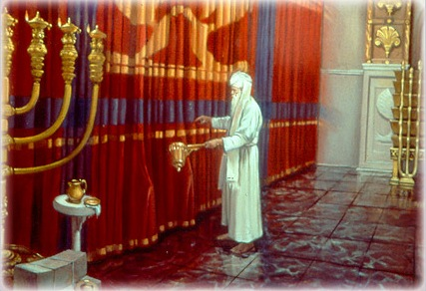
LUKE 1:
9 According to the custom of the priest's office, his lot was to burn incense when he went into the temple of YHVH.
10 And the whole multitude of the people were praying without at the time of incense.
11 And there appeared unto him an angel of YHVH standing on the right side of the altar of incense.
12 And when Zacharias saw him, he was troubled, and fear fell upon him.
13 But the angel said unto him, Fear not, Zacharias: for thy prayer is heard; and thy wife Elisabeth shall bear thee a son, and thou shalt call his name John.

Slide 71
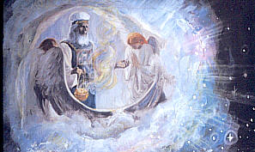
Rev 8:1 And when he had opened the seventh seal, there was silence in heaven about the space of half an hour.
2 And I saw the seven angels which stood before Elohim; and to them were given seven trumpets.
3 And another angel came and stood at the altar, having a golden censer; and there was given unto him much incense, that he should offer it with the prayers of all saints upon the golden altar which was before the throne.
4 And the smoke of the incense, which came with the prayers of the saints, ascended up before Elohim out of the angel's hand.
5 And the angel took the censer, and filled it with fire of the altar, and cast it into the earth: and there were voices, and thunderings, and lightnings, and an earthquake.
6 And the seven angels which had the seven trumpets prepared themselves to sound.

Slide 72
The Shacharit:
Revelation 8:1
¶ And when he had opened the seventh seal, there was silence in heaven about the space of half an hour.

Slide 73
REFERENCE TO KIBBUTZ GALUYOT
Romans 10:1
¶ Brethren, my heart's desire and prayer to Elohim for Israel is, that they might be saved.

Slide 74
10th Prayer is Known as Galuyot ("diasporas"), this prayer asks Elohim to allow the ingathering of the Jewish exiles back to the land of Israel

Slide 75
10. FOR GATHERING OF EXILES:
Sound the great shofar for our freedom, raise the ensign to gather our exiles, and gather us from the four corners of the earth. Blessed are you, O YHVH, who gathers the dispersed of his people Israel.
10.
T'ka b'sho-far ga-dol l'chei-ru-tei-nu, v'sa neis l'ka-beits ga-lu-yo-tei-nu, v'ka-b'-tsei-nu ya-chad [ m'hei-rah ] mei-ar-ba kan-fot ha-a-rets [ l'ar-tsei-nu ] . Ba-ruch a-tah A-do-nai, m'ka-beits nid-chei a-mo Yis-ra-eil.

Slide 76
Cornelius prayed 3 times a Day
Acts 10:
1 ¶ There was a certain man in Caesarea called Cornelius, a centurion of the band called the Italian band,
2 A devout man, and one that feared Elohim with all his house, which gave much alms to the people, and prayed to Elohim always.

Slide 77
“siddur”
The word means “order,” and comes from the same Hebrew word as “seder”used in the Passover tradition. The Siddur is an arranged “order” of prayers, written down for common use among a group of people. It is thoroughly Jewish in its content and arrangement.

Slide 78
Shacharit
The Shacharit begins by praising Hashem for the obvious—that we were given another day on this earth. It continues with the various blessings associated with preparing for the “actual” prayers of the morning. Blessings for such as the donning of tzit-tzit/tallit and tefillin begin, followed by the Morning Blessings. The Morning Blessings the contain
following:
• Modeh Ani - Prayer Upon Rising
• Ma Tovu - A prayer said upon entering the Temple or synagogue. There are some beautiful melodies traditionally associate with this prayer.
• Adon Olam - Acknowledgment of God as Creator and Sovereign of the Universe

Slide 79
• Yigdal - Summary of the 13 Principles of Faith, which were initially set forth by
Rambam
• Al Nattilat Yadayim - Blessing for the washing of hands, obligatory mitzvah preceding
prayer
• Asher Yatzar - Blessing for being able to relieve oneself
• Brachot HaTorah - Blessings for the study of Torah

Slide 80
• Birchot Hashachar - Fifteen blessings acknowledging Godʼs Sovereignty over the day
—Blessing Him for who He has created us to be, for giving sight to the blind, clothing the naked, releasing the bound, straightening the bent, etc.), followed by a blessing to start the day appropriately (waking fully, leading us not into error or sin, deliverance from those who would oppress us, etc.
• The Akeidah - Recollection of the binding of Isaac, reminding us to that our devotion to the Almighty should be more precious than our very lives

Slide 81
• The Abbreviated Shema (Deut 6:4-9 only)
• Atah - Prayer expressing Godʼs immutability
• Offerings & Incense - Prayers that include various passages recalling the specifics of
the sacrificial system, as well as a selections of the Mishnah regarding such, intending to replace the actual bringing of the offerings until such a time that sacrifices are resumed.

Slide 82
• Mizmor lʼDavid - Psalm 30 –
Introductory to the Pʼsukei Dʼzimrah
• Mournersʼ Kaddish
(Similar to the Rabbisʼ Kaddish, recited by those who have lost aparent within the last eleven months)
• Pʼsukei Dʼzimrah
(Verses of Praise - multiple blessings and Scriptures, mainly from the Psalms. This contains the Ashrei)

Slide 83
• The Full Shema
(and its introductory and concluding blessings)
Prayer
The Jewish Sages teach that there are both 248 parts in the human body and there are 248 positive commandments in the torah.

Slide 84
• Shmoneh Esrei / Amidah / Tefillah
(The central prayer of each prayer service)
• Optional Prayers:
• Vidui (Prayer of confession of sins)
www.diggingwithdarren.com

Slide 85
• Avinu Malkeinu
“Our Father, Our King” - Recited from Rosh Hashannah to Yom Kippur and during times of fasting
• Tachanun
(“Putting down the head.” Recalling and entreating the mercies of YHVH. Recited specific ways on specific days.)Mondays & Thrusdays

Slide 86
450 BC
Jewish tradition claims that the practice of the Amidah Prayer was instituted by the Patriarchs and formalized by the men of the Great Assembly, which was presided by Ezra the priestly scribe, around the year 450 BCE. Jewish scholars established the present ...The oldest form, or forms, of the Amidah Prayer predate the time of Yeshua of Nazareth (1) and was known, simply, as “The Prayer (s)”. Jewish tradition claims that the practice of the Amidah Prayer was instituted by the Patriarchs and formalized by the men of the Great Assembly, which was presided by Ezra the priestly scribe, around the year 450 BCE.

Slide 87
THE GREAT ASSEMBLY OF THE 120 MEN OF ISRAEL
HAGGAI
ZACHARIAH
MALACHI
MORDECHAI
NEHEMIAH
EZRA

Slide 88
Times of Prayer
The set times of prayer are as follows:
• Shacharit
• Mincha
• Maʼariv

Slide 89
The basic obligation of these set times of prayer are as follows:
Shacharit:
Shema and Amidah
Mincha:
Amidah
Maʼariv:
Shema and Amidah
Side Note: Some of the prayers (such as the Kaddish) are intended to only be recited in the presence of a minyan1, and should not be recited in private prayers.

Slide 90
Three time a day at the hours of prayer:
9 AM
12 NOON
3 PM

Slide 91
The prescribed times for reciting the Amidah come from the times of the public tamid ("eternal") sacrifices that took place in the Temples in Jerusalem. After the Second Temple's destruction in 70 CE, the Council of Jamnia determined that the Amidah would substitute the sacrifices, directly applying Hosea's dictate, "So we will render for bullocks the offering of our lips. Thus, the Amidah must be recited during the exact time period of the day that the substituted tamid could have been offered.

Slide 92
The Ma'ariv service was originally optional, because it in fact does not replace a specific sacrifice, but rather the burning of ashes on the altar throughout the night
(Ma'ariv has since been accepted as obligatory).

Slide 93
Three steps
Observant Jews have the custom to take three steps back and then three steps forward both before and after reciting the Amidah. The steps backward at the beginning represent withdrawing one's attention from the material world, and then stepping forward to symbolically approach the King of Kings.

Slide 94
TAKING 3 STEPS BACKWARDS
The Babylonian Talmud relates that the practice of stepping backward after the Amidah is a reminder of the practice in the Temple in Jerusalem, when those offering the daily sacrifices would walk backward from the altar after finishing. It is also compared to a student who respectfully backs away from his teacher.

Slide 95
Shimoneh Esrei
The “Standing” Prayer, also know as the Shimoneh Esrei, the Eighteen Benedictions. This prayer is so old and venerated that in the Mishnah, the oldest part of the Talmud (dating to c. 200 CE), it is simply referred to as the Prayer.
(Megillah 17b; Berakhot 28b).
The basic formula is ancient—composed by the 120 Men of the Great Assembly in the fifth century B.C.E. Shortly after the destruction of the Second Temple in the first century C.E., the form and order of these blessings were crystallized by Simon Ha-Pakuli in Yavneh at the request of Rabbi Gamliel (Megillah 17b; Berakhot 28b). (ibid. 69)

Slide 96
Bowing
The worshipper bows at four points in the Amidah: at the beginning and end of both the first blessing of Avot and the second to last blessing of Hoda'ah. At the opening words of Avot and at the conclusion of both these blessings, when the one says "Blessed are You, O YHVH," one bends one's knees at "Blessed," then bows at "are You," and straightens while saying "O YHVH." The reason for this procedure is that the Hebrew word for "blessed" (baruch) is related to "knee" (berech); while the verse in Psalms states, "YHVH straightens the bent. At the beginning of Hoda'ah, one bows while saying the opening words "We are grateful to You" without bending the knees. At each of these bows, one must bend over until the vertebrae protrude from one's back; one physically unable to do so suffices by nodding the head.

Slide 97
The Blessings of Shemoneh Esrei (Amidah)
Preliminary Preparatory Prayer
(approaching YHVH in Prayer
Middle Section
Petitions and nationalistic & summary prayer
First section
The first three blessings- Praising YHVH
Blessing 1- The Fathers
Blessing 2- YHVH’s power & Might
Blessing 3- YHVH’s Holiness
Blessing 4- Knowledge- wisdom
Blessing 5- Repentance
Blessing 6- Forgiveness
Blessing 7- Redemption & deliverance
Blessing 8- Health and Healing
Blessing 9- Material Prosperity

Slide 98
National Petitions
Blessing 10- Ingathering of the Exiles
Blessing 11- Restoration of justice
Blessing 12- Destruction of God’s Enemies
Blessing 13- Prayer for the Righteous
Blessing 14- Rebuilding of Jerusalem
Blessing 15- Coming of Messiah-Davidic Reign
Blessing 16- Prayer of Acceptance

Slide 99
The Third Section 3 Blessing Praising YHVH
Blessing 17- Restoration of the Temple Worship
Blessing 18- Thanksgiving
Blessing 19- Peace
CONCLUDING PRAYER
(MAY OUR PRAYER BE ACCEPTABLE TO YOU)

Slide 100
The nineteen blessings are as follows:
Psalms 51:15
O YHVH, open thou my lips; and my mouth shall show forth thy praise.
A-do-nai s'fa-tai tif-tach, u-fi ya-gid t'hi-la-te-cha.

Slide 101
1.
Known as Avot ("Ancestors") this prayer offers praise of Elohim as the Elohim of the Biblical patriarchs, "Elohim of Abraham,Elohim of Isaac andElohim of Jacob."

Slide 102
1. AVOT
Ba-ruch a-tah A-do-nai, Bend knees on "ba-ruch", bow on "a-tah", straighten at "A-do-nai". E-lo-hei-nu, Vei-lo-hei a-vo-tei-nu, E-lo-hei Av-ra-ham, E-lo-hei Yitz-chak, Vei-lo-hei Ya-a-kov, Ha-eil Ha-Ga-dol Ha-Gi-bor v'Ha-No-rah Eil Eil-yon, go-meil cha-sa-dim to-vim v'ko-nei ha-kol v'zo-cheir chas-dei a-vot u'mei-vi go-eil liv-nei v'nei-hem l'ma-an sh'mo b'a-ha-vah, Me-lech o-zeir u'mo-shi-a u-ma-gein
Ba-ruch a-tah A-do-nai, Bend knees on "ba-ruch", bow on "a-tah", straighten at "A-do-nai". ma-gein Av-ra-ham.
Fathers
Blessed art Thou, Lord our Elohim and Elohim of our fathers,
Elohim of Abraham, Elohim of Isaac, and Elohim of Jacob, The great, mighty, and awesome Elohim, Elohim Supreme, who extends loving kindness and is Master of all, Who remembers the gracious deeds of our fore fathers, And who will bring a Redeemer with love to their children’s children for His name’s sake. King, Helper, Savior, and Protector, Blessed art Thou, Lord, Protector of Abraham.

Slide 103
Moses appealing to YHVH
EXODUS 32:13
Remember Abraham, Isaac, and Israel, thy servants, to whom thou swore by your own self, and said unto them, I will multiply your seed as the stars of heaven, and all this land that I have spoken of will I give unto your seed, and they shall inherit it for ever.

Slide 104
Gevurot ("powers"),
2.
Known as Gevurot ("powers"), this offers praise of Elohim for His power and might. This prayer includes a mention of Elohim's healing of the sick and resurrection of the dead. It is called also Tehiyyat ha-Metim = "the resurrection of the dead."
Rain is considered as great a manifestation of power as the resurrection of the dead; hence in winter a line recognizing Elohim's bestowal of rain is inserted in this benediction. Except for many Ashkenazim, most communities also insert a line recognizing dew in the summer.

Slide 105
Powers
Thy might is eternal, O YHVH,
Who revives the dead, Powerful in saving, Who makes the wind to blow and the rain to fall, [Said only in winter] Who sustains the living with loving kindness, Who revives the dead with great mercy, Who supports the falling, heals the sick, frees the captive, And keeps faith with the dead; Who is like Thee, Almighty, and who resembles Thee, O King who can bring death and give life, And can make salvation blossom forth. And faithful art Thou to revive the dead. Blessed art Thou, Lord, who makes the dead live.
2. GIVUROT
A-tah gi-bur l'o-lam, A-do-nai m'chai-yei mei-tim a-ta rav l'ho-shi-a,
Only between Sukkot and Pesach: ma-shiv ha-ru-ach u-mo-rid ha-ga-shem
[ At other times, Nusach Sfard congregations say:
mo-rid ha-tal ]
m'chal-keil cha-yim b'che-sed m'cha-yei mei-tim b'ra-cha-mim ra-bim so-meich no-f'lim v'ro-fei cho-lim u-ma-tir a-su-rim u-m'kai-yeim e-mu-na-to li-shei-nei a-far mi cha-mo-cha ba-al g'vu-rot u-mi do-me lach me-lech mei-mit u-m'chai-ye u-matz-mi-ach y'shu-a, v'ne-e-man a-tah l'ha-cha-yot mei-tim
Ba-ruch a-tah A-do-nai, m'cha-yei ha-mei-tim.

Slide 106
The doctrine of the Resurrection of the dead was of such importance to Pharisaic Judaism, which became Orthodox Judaism, that the sages decreed,
On Tannaite authority [it was stated], “Such a one denied the resurrection of the dead, therefore he will not have a portion in the resurrection of the dead. For all the measures [meted out by] the Holy One, blessed be he, are in accord with the principle of measure for measure.” (b. Sanhedrin 90a)

Slide 107
3.
Known as Kedushat ha-Shem
("the sanctification of the Name") this offers praise of Elohim's holiness.
During the chazzan's repetition, a longer version of the blessing called Kedusha is chanted responsively. The Kedusha is further expanded on Shabbat and Festivals.

Slide 108
Known as Kedushat ha-Shem ("the sanctification of the Name") this offers praise ofElohim's holiness.
3. K'DUSHAT HASHEM
A-tah ka-dosh, v'shim-cha ka-dosh, u-k'do-shim b'chawl-yom y'ha-l'lu-cha se-lah. [ Ki Eil me-lech ga-dol v'ka-dosh a-tah. ] Ba-ruch a-tah A-do-nai, ha-Eil ha-ka-dosh.
Holiness
Thou art holy, and Thy name is holy, And those who are holy shall praise Thee every day. Blessed art Thou, Lord, the holy Elohim.
http://www.siddur.org/transliterations/SatAM/12shacharit_amidah.php#avot

Slide 109
This is where the Jews require a Minyan 10 man for prayer
Leviticus 22:32
Neither shall ye profane my holy name; but I will be hallowed among the children of Israel: I am YHVH which hallow you,

Slide 110
Kadosh
Isaiah 6:3
And one cried unto another, and said, Holy, holy, holy, is YHVH of hosts: the whole earth is full of his glory.

Slide 111
4.
Known as Binah ("understanding") this is a petition to Elohim to grant wisdom and understanding.

Slide 112
Knowledge / Daat
Thou grant knowledge to man, And teach understanding to humans; From Thine own Self, favor us with knowledge, understanding, and sense. Blessed art Thou, Lord, giver of knowledge.
4.
A-tah cho-nein l'a-dam da-at, um-la-meid le-e-nosh bi-nah. Cha-nei-nu mei-i-t'cha dei-ah bi-nah v'has-keil | chach-ma bi-nah v'da-at. > Ba-ruch a-tah A-do-nai, cho-nein ha-da-at.

Slide 113
Why is the prayer for Binah after kedushat Hashem
Isaiah 29:
23 But when he sees his children, the work of mine hands, in the midst of him, they shall sanctify my name, and sanctify the Holy One of Jacob, and shall fear the Elohim of Israel.
24 They also that erred in spirit shall come to understanding, and they that murmured shall learn doctrine. {come...: Heb. know understanding}

Slide 114
5.
Ha-shi-vei-nu A-vi-nu l'to-ra-te-cha, v'ka-r'vei-nu Mal-kei-nu la-a-vo-da-te-cha, v'ha-cha-zi-rei-nu bit-shu-vah sh'lei-mah l'fa-ne-cha. Ba-ruch a-tah A-do-nai, ha-ro-tseh bit-shu-vah.
Repentance
Return us, our Father, to Thy Torah, And draw us closer, our King, to Thy worship, And bring us back before Thee in complete repentance.
Blessed art Thou, Lord, who desires repentance.

Slide 115
That Elohim desires repentance rather than to destroy the wicked is the consistent teaching throughout Scripture:
“’For I have no pleasure in the death of anyone who dies,’ declares YHVH ADONAI. ‘Therefore, repent and live’" (Ezk. 18:32).
“YHVH is not slow about His promise, as some count slowness, but is patient toward you, not wishing for any to perish but for all to come to repentance” (2Pt. 3:9).

Slide 116
Forgiveness
Forgive us Father, for we have sinned, Pardon us, our King, for we have transgressed, For Thou art a pardoner and a forgiver. Blessed art Thou, Lord, Gracious One who forgives abundantly.
6.
S'lach la-nu A-vi-nu ki cha-ta-nu, m'chal la-nu Mal-kei-nu ki fa-sha-nu, < ki mo-cheil v'so-lei-ach a-ta. ki Eil tov v'sa-lach a-ta. >
Ba-ruch a-tah A-do-nai, cha-nun ha-mar-beh lis-lo-ach.

Slide 117
Isaiah 55:7
Let the wicked forsake his way, and the unrighteous man his thoughts: and let him return unto YHVH, and he will have mercy upon him; and to our Elohim, for he will abundantly pardon.

Slide 118
It is traditional to beat on one’s breast when saying this part of the Prayer, specifically at the words “forgive” and “pardon.” This brings to mind the tax collector Yeshua spoke of in one of His teachings:
(Luke 18:13)
But the tax collector, standing some distance away, was even unwilling to lift up his eyes to heaven, but was beating his breast, saying, “Elohim, be merciful to me, the sinner!”

Slide 119
Redemption
Look upon us in our suffering, And fight our struggles, Redeem us speedily, for Thy Name’s sake, For Thou art a mighty Redeemer. Blessed art Thou, Lord, Redeemer of Israel.
7.
R'ei na v'an-yei-nu, v'ri-va ri-vei-nu, ug-a-lei-nu [ g'u-lah sh'lei-mah ] m'hei-rah l'ma-an sh'me-cha, ki [ Eil ] go-eil cha-zak a-ta. Ba-ruch a-tah A-do-nai, go-eil Yis-ra-eil.

Slide 120
Isaiah 49:
7 ¶ Thus saith YHVH, the Redeemer of Israel, and his Holy One, to him whom man despiseth, to him whom the nation abhorreth, to a servant of rulers, Kings shall see and arise, princes also shall worship, because of YHVH that is faithful, and the Holy One of Israel, and he shall choose thee. {whom man...: or, that is despised in soul}
8 Thus saith YHVH, In an acceptable time have I heard thee, and in a day of salvation have I helped thee: and I will preserve thee, and give thee for a covenant of the people, to establish the earth, to cause to inherit the desolate heritages;

Slide 121
Isaiah 59:20
And the Redeemer shall come to Zion, and unto them that turn from transgression in Jacob, saith YHVH.

Slide 122
Healing
8.
R'fa-ei-nu A-do-nai v'nei-ra-fei, ho-shi-ei-nu v'ni-va-shei-a, ki t'hi-la-tei-nu a-ta, v'ha-a-lei < r'fu-ah sh'lei-mah | a-ru-cha u-mar-pei l'chawl ta-cha-lu-ei-nu u-l'chawl mach-o-vei-nu u- > l'chawl ma-ko-tei-nu, [At this point, many interject personal petitions concerning individuals who are ill.] ki Eil me-lech [ ga-dol ] ro-fei ne-e-man v'ra-cha-man a-ta. Ba-ruch a-tah A-do-nai, ro-fei cho-lei a-mo Yis-ra-eil.
Heal us, O YHVH, and we shall be healed, Save us and we shall be saved, For Thou art our glory. Send complete healing for our every illness For Thou, Divine King, art the faithful, merciful Physician. Blessed are Thou, Lord, who heals the sick of His people Israel.

Slide 123
Psalms 103:3
Who forgiveth all thine iniquities; who healeth all thy diseases;
Jeremiah 17:14
Heal me, O YHVH, and I shall be healed; save me, and I shall be saved: for thou art my praise.

Slide 124
Matthew, writing about Yeshua’s healing ministry, quotes Isaiah 53:
(Mat. 8:14-17)
When Yeshua came into Peter’s house, He saw his wife’s mother lying sick with a fever. He touched her hand, and the fever left her. She got up and served Him. When evening came, they brought to Him many possessed with demons. He cast out the spirits with a word, and healed all who were sick; that it might be fulfilled which was spoken through Isaiah the prophet, saying: “He took our infirmities, and bore our diseases.”

Slide 125
Prosperity of the Year
Ba-reich a-lei-nu A-do-nai E-lo-hei-nu et ha-sha-nah haz-zot v'et kawl mi-nei t'vu-a-tah, from the third night of Passover through the afternoon of December 4th (December 5th if the following February will be 29 days): v'tein b'ra-cha from the evening of December 4th (or 5th) through erev Pesach: v'tein tal u-ma-tar liv-ra-cha at all times, continue: al p'nei ha-a-da-mah, v'sa-b'ei-nu < mi-tu-ve-cha | mi-tu-vah >, u-va-reich sh'na-tei-nu ka-sha-nim ha-to-vot [ liv-ra-cha ], | From Passover through December 4th, some congregations recite this instead: Ba-r'chei-nu, A-do-nai E-lo-hei-nu, b'chawl ma-a-sei ya-dei-nu, u-va-reich sh'na-tei-nu b'ta-l'lei ra-tson b'ra-cha un-da-vah. Ut-hi a-cha-ri-tah chai-yim v'so-va v'sha-lom, ka-sha-nim ha-to-vot liv-ra-cha.
Bless this year for us, O YHVH our Elohim, and all its varied produce that it be for good; Provide (dew and rain for*) a blessing on the face of the earth, Satisfy us with Thy goodness, and bless this year like the good years. Blessed art Thou, Lord, who blesses the years.
*Prayed only during the winter months, Israel’s rainy season
[ ki Eil tov u-mei-tiv a-ta, um-va-reich ha-sha-nim. ] Ba-ruch a-tah A-do-nai, m'va-reich ha-sha-nim.

Slide 126
Ingathering of the Exiles
10.
T'ka b'sho-far ga-dol l'chei-ru-tei-nu, v'sa neis l'ka-beits ga-lu-yo-tei-nu, v'ka-b'-tsei-nu ya-chad [ m'hei-rah ] mei-ar-ba kan-fot ha-a-rets [ l'ar-tsei-nu ] . Ba-ruch a-tah A-do-nai, m'ka-beits nid-chei a-mo Yis-ra-eil.
Sound the great shofar for our freedom, Lift up a banner for the ingathering of our exiles, And bring us together from the four corners of the earth. Blessed art Thou, Lord, who gathers together the dispersed of His people Israel.

Slide 127
Deuteronomy 30:
1 ¶ And it shall come to pass, when all these things are come upon thee, the blessing and the curse, which I have set before thee, and thou shalt call them to mind among all the nations, whither YHVH thy Elohim hath driven thee,
2 And shalt return unto YHVH thy Elohim, and shalt obey his voice according to all that I command thee this day, thou and thy children, with all thine heart, and with all thy soul;
3 That then YHVH thy Elohim will turn thy captivity, and have compassion upon thee, and will return and gather thee from all the nations, whither YHVH thy Elohim hath scattered thee.
4 If any of thine be driven out unto the outmost parts of heaven, from thence will YHVH thy Elohim gather thee, and from thence will he fetch thee:
5 And YHVH thy Elohim will bring thee into the land which thy fathers possessed, and thou shalt possess it; and he will do thee good, and multiply thee above thy fathers.

Slide 128
Jeremiah 29:
12 Then shall ye call upon me, and ye shall go and pray unto me, and I will hearken unto you.
13 And ye shall seek me, and find me, when ye shall search for me with all your heart.
14 And I will be found of you, saith YHVH: and I will turn away your captivity, and I will gather you from all the nations, and from all the places whither I have driven you, saith YHVH; and I will bring you again into the place whence I caused you to be carried away captive.

Slide 129
Isaiah 11:
12 And he shall set up an ensign for the nations, and shall assemble the outcasts of Israel, and gather together the dispersed of Judah from the four corners of the earth. {corners: Heb. wings}
13 The envy also of Ephraim shall depart, and the adversaries of Judah shall be cut off: Ephraim shall not envy Judah, and Judah shall not vex Ephraim.

Slide 130
Hoshea 1:
10 Yet the number of the children of Israel shall be as the sand of the sea, which cannot be measured nor numbered; and it shall come to pass, that in the place where it was said unto them, Ye are not my people, there it shall be said unto them, Ye are the sons of the living Elohim. {in...: or, instead of that}
11 Then shall the children of Judah and the children of Israel be gathered together, and appoint themselves one head, and they shall come up out of the land: for great shall be the day of Jezreel.

Slide 131
Moshiach Ben David
Matthew 24:
30 And then shall appear the sign of the Son of man in heaven: and then shall all the tribes of the earth mourn, and they shall see the Son of man coming in the clouds of heaven with power and great glory.
31 And he shall send his angels with a great sound of a trumpet, and they shall gather together his elect from the four winds, from one end of heaven to the other.

Slide 132
Known as Birkat HaDin
("Justice")
this prayer asks Elohim to restore righteous judges as in the days of old.

Slide 133
11. FOR THE RIGHTEOUS REIGN OF Elohim:
Restore our judges as in former times, and our counselors as at the beginning; and remove from us sorrow and sighing. Reign over us, you alone, O YHVH, with loving kindness and compassion, and clear us in judgment. Blessed are you, O YHVH, the King who loves righteousness and justice.

Slide 134
Isaiah 1:26
I will restore your judges as at the first, and your counselors as at the beginning. Afterward you shall be called 'The city of righteousness, a faithful town.'

Slide 135
12. FOR THE DESTRUCTION OF APOSTATES AND THE ENEMIES OF Elohim:
Let there be no hope for slanderers, and let all wickedness perish in an instant. May all your enemies quickly be cut down, and may you soon in our day uproot, crush, cast down and humble the dominion of arrogance. Blessed are you, O YHVH, who smashes enemies and humbles the arrogant.
*Prayer against believers in Yeshua and the Sadducees

Slide 136
13. FOR THE RIGHTEOUS AND PROSELYTES:
May your compassion be stirred, O YHVH our Elohim, towards the righteous, the pious, the elders of your people the house of Israel, the remnant of their scholars, towards proselytes, and towards us also. Grant a good reward to all who truly trust in your name. Set our lot with them forever so that we may never be put to shame,for we have put our trust in you. Blessed are you, O YHVH, the support and stay of the righteous.

Slide 137
Numbers 15:
14 If a stranger lives as a foreigner with you, or whoever may be among you throughout your generations, and will offer an offering made by fire, of a sweet savor to YHVH; as you do, so he shall do.
15 For the assembly, there shall be one statute for you, and for the stranger who lives as a foreigner [with you], a statute forever throughout your generations: as you are, so shall the foreigner be before YHVH.
16 One law and one ordinance shall be for you, and for the stranger who lives as a foreigner with you.

Slide 138
14. FOR THE REBUILDING OF JERUSALEM:
Return in mercy to Jerusalem your city, and dwell in it as you have promised. Rebuild it soon in our day as an eternal structure, and quickly set up in it the throne of David. Blessed are you, O YHVH, who rebuilds Jerusalem.

Slide 139
15. FOR THE MESSIANIC KING:
Speedily cause the offspring of your servant David to flourish, and let him be exalted by your saving power, for we wait all day long for your salvation. Blessed are you, O YHVH, who causes salvation to flourish.

Slide 140
16. FOR THE ANSWERING OF PRAYER:
Hear our voice, O YHVH our Elohim; spare us and have pity on us. Accept our prayer in mercy and with favor, for you are a Elohim who hears prayers and supplications. O our King, do not turn us away from your presence empty-handed, for you hear the prayers of your people Israel with compassion. Blessed are you, O YHVH, who hears prayer.

Slide 141
17. FOR RESTORATION OF TEMPLE SERVICE:
Be pleased, O YHVH our Elohim, with your people Israel and with their prayers. Restore the service to the inner sanctuary of your Temple, and receive in love and with favor both the fire-offerings of Israel and their prayers. May the worship of your people Israel always be acceptable to you. And let our eyes behold your return in mercy to Zion. Blessed are you, O YHVH, who restores his divine presence to Zion.

Slide 142
18. THANKSGIVING FOR ELOHIM’S UNFAILING MERCIES:
We give thanks to you that you are YHVH our Elohim and the Elohim of our fathers forever and ever. Through every generation you have been the rock of our lives, the shield of our salvation. We will give you thanks and declare your praise for our lives that are committed into your hands, for our souls that are entrusted to you, for your miracles that are daily with us, and for your wonders and your benefits that are with us at all times, evening, morning and noon. O beneficent one, your mercies never fail; O merciful one, your loving kindnesses never cease. We have always put our hope in you. For all these acts may your name be blessed and exalted continually, O our King, forever and ever. Let every living thing give thanks to you and praise your name in truth, O Elohim, our salvation and our help. (Selah.)Blessed are you, O YHVH, whose Name is the Beneficent One, and to whom it is fitting to give thanks.

Slide 143
19. FOR PEACE:
Grant peace, welfare, blessing, grace, loving kindness and mercy to us and to all Israel your people. Bless us, O our Father, one and all, with the light of your countenance; for by the light of your countenance you have given us, O YHVH our Elohim, a Torah of life, loving kindness and salvation, blessing, mercy, life and peace. May it please you to bless your people Israel at all times and in every hour with your peace. Blessed are you, O YHVH, who blesses his people Israel with peace.

Slide 144
Tachanun (“Putting down the head.” Recalling and entreating the mercies of YHVH..)
Recited in a specific ways on specific days
MONDAYS AND THURSDAYS

Slide 145
After this at public prayer in the morning the priestly blessing is added.
Numbers 6:
22 YHVH spoke to Moshe, saying,
23 "Speak to Aharon and to his sons, saying, 'This is how you shall bless the children of Yisra'el.' You shall tell them,
24 'YHVH bless you, and keep you.
25 YHVH make his face to shine on you, and be gracious to you.
26 YHVH lift up his face toward you, and give you shalom.'
27 "So they shall put my name on the children of Yisra'el; and I will bless them."

Slide 146
THE TORAH SERVICE AND THE MESSIAH

Slide 147
• Torah Service
• Ashrei (The second recitation of Psalm 145)
• Lamnaʼzeʼach (Pslam 20)
• Uva Lʼtzion
(Combination of praises from various angels in Scripture, and prayer that
we would serve the Almighty in such a capacity)
• Full Kaddish
(Extended Remix of the Rabbisʼ Kaddish)

Slide 148
• Aleinu
(A core statement of monotheism and refutation of idolatry)
• Mournerʼs Kaddish (Second time)
• Song of the Day (Selected chapter of Psalms corresponding to the Psalm that was recited on the specific day within the Temple)

Slide 149
The Torah service is about the Worship of the King and Savior
The Zenith of the Service in the Synagogue is the opening of the Ark.
Singing Ki Mi-tzion Tetse Torah which speaks about the time when the Torah shall come forth from Jerusalem.
Presenting the Torah to the People.
Procession of the Torah Scroll (Word of YHVH) amongst the congregation

Slide 150
THE MOSHIACH IN THE TORAH
Numbers 10:
35 It happened, when the ark set forward, that Moshe said, Rise up, LORD, and let your enemies be scattered; and let those who hate you flee before you.
36 When it rested, he said, Return, LORD, to the ten thousands of the thousands of Yisra'el.

Slide 152
Inverted Nun n What does it mean?

Slide 153
Nun n
1. Numerical value of 50
2. Nun in Paleo hebrew is like a seed
3. In Aramaic NUN tipyfied a Fish
4. Yahoshua Ben Nun = Salvation of YHVH Son of Life
5. Apears in the Masoretic text 9 times
6. Twice in Numbers, 10:35-36
7. 7 times in Psalms 107
8. Nun is the 14th letter in the Hebrew alphabet and 14 is the numerical value of the name David

Slide 154
Jonathan Ben Uzziel Targum dice:
Numbers 10:
35 It happened, when the ark set forward, that Moshe said, Rise up, O Memra of YHVH, and let your enemies be scattered; and let those who hate you flee before you.
36 When it rested, he said, Return, Memra of YHVH, to the ten thousands of the thousands of Yisra'el.

Slide 155
The Torah service is about the Worship of the King and Savior
The Zenith of the Service in the Synagogue is the opening of the Ark.
Singing Ki Mitzion Tetse Torah which speaks about the time when the Torah shall come forth from Jerusalem.
Presenting the Torah to the People.
Procession of the Torah Scroll (Word of YHVH) amongst the congregation

Slide 156
קטרת

Slide 157
The Ketoret, offered up twice a day, symbolized Israel's desire to serve HaShem in a pleasing way. This offering was brought twice daily, once as part of the Shacharit (morning) service and once as part of the Mincha / Musaf (afternoon) service. This happened seven days a week, every day of the year, including Shabbat and Yom HaKippurim. Five pounds of ketoret was burnt daily, half in the morning and half in the afternoon.
Shemot (Exodus) 30:7
And Aaron shall burn thereon sweet incense every morning: when he dresseth the lamps, he shall burn incense upon it. 8 And when Aaron lighteth the lamps at even, he shall burn incense upon it, a perpetual incense before HaShem throughout your generations.

Slide 158
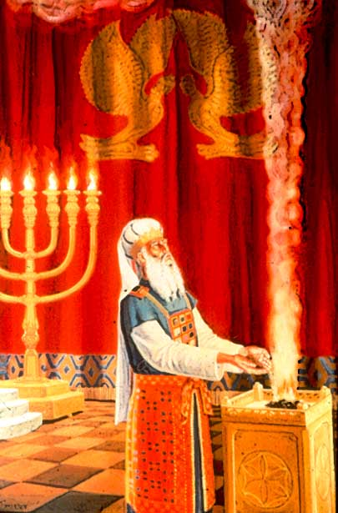

Slide 159
Ketoret Symbolizes Prayer
Berachoth 6b
R. Helbo further said in the name of R. Huna: A man should always take special care about the afternoon-prayer. For even Elijah was favourably heard only while offering his afternoon-prayer. For it is said: And it came to pass at the time of the offering of the evening offering, that Elijah the prophet came near and said . . . Hear me, O YHVH, hear me. ‘Hear me’, that the fire may descend from heaven, and ‘hear me’, that they may not say it is the work of sorcery. R. Johanan says: [Special care should be taken] also about the evening-prayer. For it is said: Let my prayer be set forth as incense before Thee, the lifting up of my hands as the evening sacrifice. R. Nahman b. Isaac says: [Special care should be taken] also about the morning.prayer. For it is said: O YHVH, in the morning shalt Thou hear my voice; in the morning will I order my prayer unto Thee, and will look forward.

Slide 160
According to the Zohar, the incense offering is the most precious part of the Temple service in the eyes of HaShem. The ketoret was so desirable that the Kohanim (Priests) had to wait to do it. No Kohen (Priest) ever did it twice in order to give all the Kohanim the chance to do it at least once. One of the reasons that the ketoret offering was so desireable was because the ketoret offering was a way to increase one's wealth, as the Talmud indicates:
Yoma 26a It never happened that a person repeatedly offered incense. Why? Rabbi Chanina said: Because, the Incense-Offering enriches.
The procedure regarding the Ketoret is that a Kohen does not perform the mitzva of offering ketoret more than once in his lifetime. Elohim rewards the Kohen who offers the ketoret with wealth. Thus, we want to afford the opportunity to as many Kohanim as possible to become wealthy.

Slide 161
Holy Deodorizer
Maimonides describes the function of the ketoret as the vanquishing of the unpleasant odors that might otherwise have pervaded the Temple. YHVH commanded that the ketoret be burned twice a day, each morning and afternoon, to lend a pleasing fragrance to the Temple and to the garments of those who served in it:
Guide for the Perplexed, part III, ch. 45
“Since many animals were slaughtered in the sacred place each day, their flesh butchered and burnt and their intestines cleaned, its smell would doubtless have been like the smell of a slaughterhouse... Therefore G-d commanded that the ketoret be burned twice a day, each morning and afternoon, to lend a pleasing fragrance to [the Holy Temple] and to the garments of those who served in it.”

Slide 162
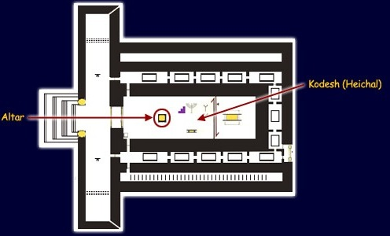
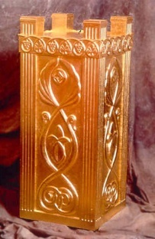
The Holy Temple Instruments: Altar of Incense
HAB/WLB 2008 / www.templeinstitute.org

Slide 163
The Holy Temple Instruments: Altar of Incense
The Altar of Incense is also known in the Scriptures as the Incense Altar, the Altar of Gold, the Golden Altar, the Altar to Burn Incense, the Altar of Sweet Incense, the Altar before YHVH, or the Whole Altar that is by the Oracle. The Altar of Incense is a prophetic picture of Yeshua, our Intercessor.
HAB/WLB 2008 / www.templeinstitute.org and www.templebuilders.com

Slide 164
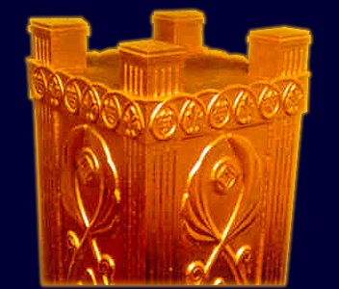
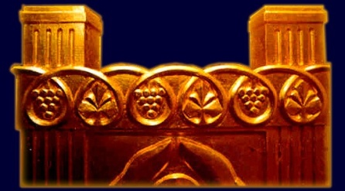
The Incense Altar stood between the Shewbread Table and Menorah, a bit to the east. The Incense Altar was built of wood and overlaid with gold and was thus also known as "the golden altar.“
Four horns protrude from the top of each of the four corners of the altar. On these four horns, blood from the inner sin-offerings was sprinkled, starting with the northeastern horn and ending with the southeastern horn. (Source: Eruvin 19.)
Around the horns of the altar there was a golden wreath - symbolizing the crown of the priesthood.

Slide 165
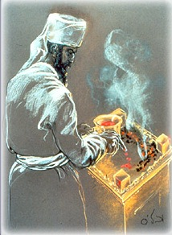
The Holy Temple Instruments: Altar of Incense
The Incense Altar, also called the Golden Altar, was one of the three vessels located in the Holy Place. The incense was burned twice each day on top of the Incense Altar. The altar symbolized the "golden mean" - the moderate path with regard to attributes and behavior. The altar is seen as representing the balanced combination of spiritual and material
abundance.
The top of the Incense Altar was made of pure gold, the thickness of a dinar (a coin). The Talmud relates that it was a miracle that the coals did not melt the gold, despite its thinness. On the top of the altar, one half portion (a pras) of incense was burnt twice each day, in the morning and at twilight. When the inner sin-offerings (such as the bull and goat on Yom Kippur) were brought, the coals from the incense that was lit that morning were pushed aside before the blood of the inner sin-offerings was sprinkled seven times on the top of the altar.
HAB/WLB 2008 / www.templeinstitute.org

Slide 166
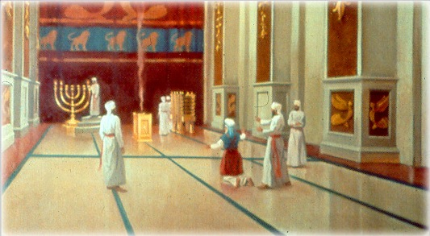
The Incense Altar was a sacred vessel like the other vessels in the Temple. There is an opinion of one of the commentaries that during the time of the First Temple the altar was part of the Temple structure.
Incense was offered twice daily – in the morning and at twilight.

Slide 167
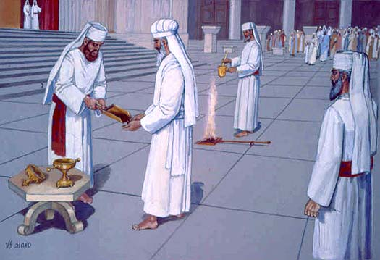
Altar of Incense at Yom Kippur
THE INCENSE SERVICE AT YOM KIPPUR
"He shall take a shovelful of burning coals from the altar that is before YHVH, and a double handful of finely ground incense, and he will bring them (into the inner sanctuary) beyond the curtain" (Lev. 16:12).
HAB/WLB 2008 / www.templeinstitute.org

Slide 168
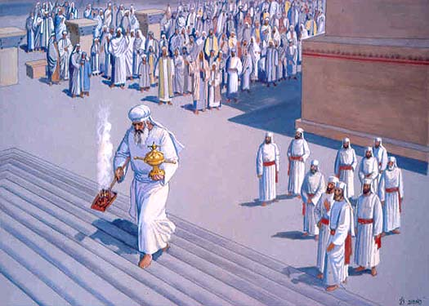
A "DOUBLE HANDFUL"
After having placed the shovelful of burning coals on the floor near the Sanctuary, other priests now bring their senior the two other items he will use to conduct the incense service: a large golden spoon (empty) which was brought from the Chamber of Vessels, and a golden shovel, filled with finely ground incense, brought from the Chamber of the Avtinas Family where the incense is prepared.
From the verse above, the sages deduced that the High Priest must remove the incense from the shovel directly into his two palms, without the aid of a vessel; this is the Bible's requirement - "a double handful of finely ground incense." Thus, there was no set measurement of how much incense was to be brought. It was literally the amount which fitted into each High Priest's palms; the amount therefore differed for each man depending on the size of his hands.

Slide 169
ENTERING INTO THE SANCTUARY
He then places the incense in his hands into the golden spoon and holds it with his left hand. In his right hand, he picks up the shovelful of burning coals from the floor before him. In this manner, carrying the spoonful of incense and the shovel of coals, he enters into the Sanctuary until he comes to the two curtains which separate between the Holy (the Sanctuary, which housed the menorah, table and incense altar) and the Holy of Holies.
In the First Temple, a wall the thickness of one amah (app. 48 or 60 centimeters) separated between these two areas. However, in the Second Temple the two curtains once again formed this distinction, as in the days of the Tabernacle. The two curtains themselves were separated by an empty space measuring one amah wide, like that wall which stood in Solomon's Temple.

Slide 170
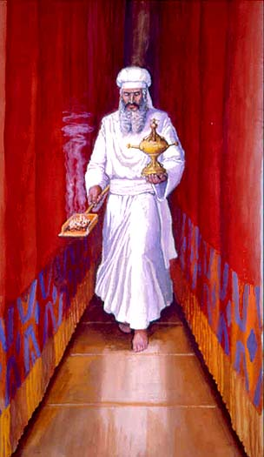
Altar of Incense at Yom Kippur
BETWEEN THE CURTAINS
One end of each of these two curtains was folded over on the outside and pinned up by a golden clasp; the outer curtain was pinned on the southern side, and the inner, on the northern side. Thus an aisle was formed which provided an open passageway between the two curtains. Carrying the implements, the High Priest walked between the curtains until he reached the northern side of the inner curtain - the spot where
it was held up.
HAB/WLB 2008 / www.templeinstitute.org

Slide 171
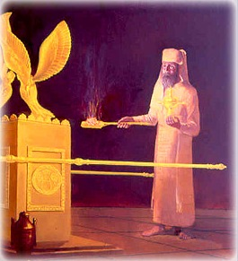
IN THE HOLY OF HOLIES
Here the High Priest stood at the opening of the Holy of Holies. He now turns and faces the south with his left side along the length of the curtain, so that he may walk to the center of the room to stand in the place known as "between the poles" – between the two poles of the Ark of the Testimony. However, the Holy of Holies was empty ... for the Ark of the Testimony did not stand in the Second Temple.

Slide 172
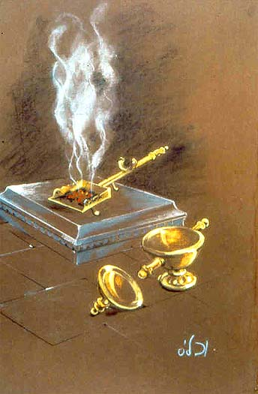
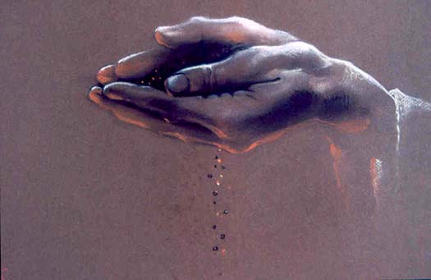
Altar of Incense at Yom Kippur
PLACING THE COALS DOWN: SECOND TEMPLE
But in the face of the ark's absence in the Second Temple era, he would place the shovel down on the foundation stone itself, in the place where the poles would be extending had the ark been there.
THE MOST DIFFICULT TASK OF ALL
Once the High Priest put down the shovel, he must then return the fine incense powder from the spoon and back into his palms - for when he places the incense on the coals, it must be directly from his palms, the "double handful." This was the most difficult task ever done by one person in the Holy Temple; it required great expertise.
HAB/WLB 2008 / www.templeinstitute.org

Slide 173
It would appear to be a nearly impossible feat for someone who had not practiced and been totally prepared. It was done in the following manner: The High Priest takes the spoon full of incense and slowly pulls it with his two thumbs against his arms and body, with the handle resting against him (some maintain that he actually held the top of the handle in his teeth). He balances the body of the spoon itself until it is level with his hands. Then he gently leans the spoon into his palms, turning and rocking it back and forth so that the contents are emptied into his palms.

Slide 174
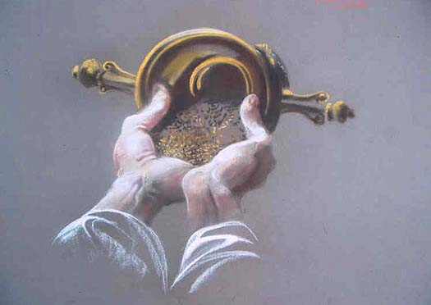
NOT EVEN ONE GRAIN MAY FALL
As we have described it, this process is difficult enough to accomplish. But what makes the excercise even more formidable - enough to merit the appellation of "the most difficult task of all" - is the requirement that the High Priest must not allow even one tiny grain to fall. The entire contents within the spoon must be completely transfered to his hands, to the very last drop. For if even a negligible measure is missing, then the amount he will be placing on the coals is no longer a double handful, for something fell from his hands. Thus he would not be fulfilling Elohim's requirement.

Slide 175
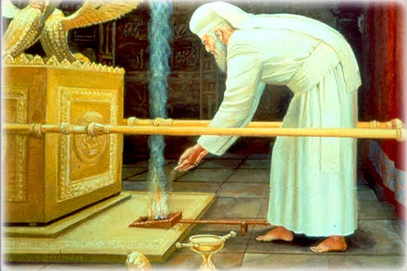
PLACING THE COALS DOWN: IN THE FIRST TEMPLE
When the Tabernacle and First Temple stood, the High Priest faced the holy Ark of the Testimony and placed the shovel of coals down, directly between the two poles of the ark.

Slide 176
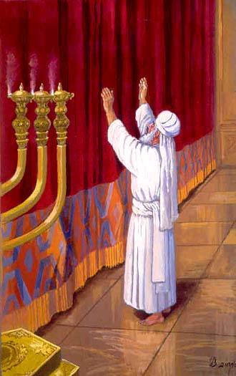
Altar of Incense at Yom Kippur
PLACING THE INCENSE ON THE COALS
From his palms the High. He stands there and waits momentarily, until the entire chamber is filled with smoke. Priest places the incense onto the coals in the shovel, on the side of the shovel away from where he is standing, so that he will not be burned as the flames ignite
The Yom Kippur incense offering completed, he then exits the Holy of Holies with extreme reverance - backwards, entering through the two curtains back into the Sanctuary without once having turned his back on the holy place.
HAB/WLB 2008 / www.templeinstitute.org

Slide 177
THE HIGH PRIEST'S "SHORT" PRAYER
Standing alone in the Sanctuary, the High Priest has successfully entered
and exited the holiest place on earth - the center of creation and of Elohim's
glory. He has made atonement for his people in the manner which Elohim
has prescribed for this holy day. Thus it would be most natural for him to reflect upon this rarefied moment of Divine communion by offering his own heartfelt prayer.
Yet this prayer, recorded by the Talmud, is remarkably short and concise:
"May it be Your will, Lord our Elohim, that if this coming year be hot, that it
also be rainy; and may the scepter not depart from the house of Judah
(see Gen. 49:10); and may Your people Israel not be dependent on each
other for their livelihood; and do not pay heed to the prayers of wayfarers
(who pray that it should not rain, so that they will not be inconvenienced
in their journey)."

Slide 178
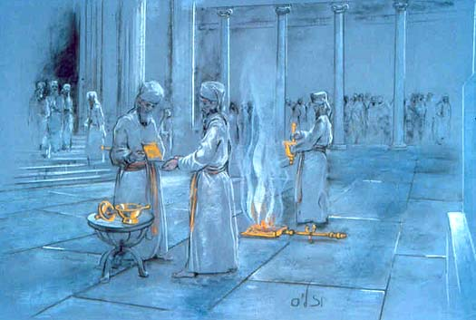
Altar of Incense at Yom Kippur
There was good reason for the High Priest's decision not to elongate his prayer at this particular time: many a High Priest was struck down dead while in the Holy of Holies. Although the First Temple stood for 410 years, in all there were only 12 High Priests during that entire period; because they were very righteous, they were blessed with longevity. However the Second Temple, which stood for a total of 420 years, was presided over by more than 300 High Priests. This is because in the spiritual decline of those days, many of these men were corrupted, and bought their office through influence.
Additionally, if he would change any detail of the incense service within the Holy of Holies (as we mentioned with regard to the Sadducees), he would also die. With this is mind, it is understandable that the eyes of all Israel awaited the exit of the High Priest with bated breath.
Being aware of his people's agitation, the High Priest's first concern was that he should not cause them any unnecessary anxiety... and the longer he stayed within, the more Israel's apprehension grew. Thus the High Priest saw fit to forego the opportunity to engage in a long personal prayer, and recited the shorter version so as to exit the Sanctuary with reasonable speed.
HAB/WLB 2008 / www.templeinstitute.org

Slide 179
EXITING - AND REENTERING
In the next stage of the Yom Kippur service, after the High Priest concluded the incense service, uttered his prayer and exits the Sanctuary, he returns to the priest who is waiting for him outside the entrance. This priest has been waiting here since the bullock was slaughtered, holding the mizrak and moving it about so that its contents will not harden.
The High Priest now receives this vessel from his colleague and returns back into the Holy of Holies a second time, exactly as he did previously. Walking through the two curtains and carrying the vessel holding the blood of his offering, he comes back to spot "between the poles" where he placed the incense on the coals atop the foundation stone.

Slide 180
Altar of Incense in Scriptures
Lev 16:12
And he shall take a censer full of burning coals of fire from off the altar before YHVH, and his hands full of sweet incense beaten small, and bring it within the vail:
Lev 16:13
And he shall put the incense upon the fire before YHVH, that the cloud of the incense may cover the mercy seat that is upon the testimony, that he die not:
HAB/WLB 2008 / www.templeinstitute.org and www.templebuilders.com

Slide 181
Rev 8:1 And when he had opened the seventh seal, there was silence in heaven about the space of half an hour.
2 And I saw the seven angels which stood before Elohim; and to them were given seven trumpets.
3 And another angel came and stood at the altar, having a golden censer; and there was given unto him much incense, that he should offer it with the prayers of all saints upon the golden altar which was before the throne.
4 And the smoke of the incense, which came with the prayers of the saints, ascended up before Elohim out of the angel's hand.
5 And the angel took the censer, and filled it with fire of the altar, and cast it into the earth: and there were voices, and thunderings, and lightnings, and an earthquake.
6 And the seven angels which had the seven trumpets prepared themselves to sound.

Slide 182
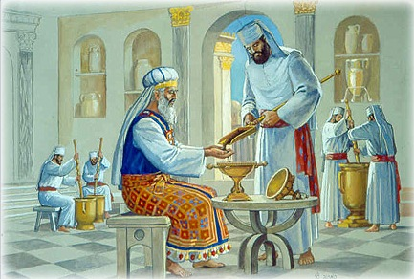
Details on the Incense Ingredients
The Bible states "Elohim said to Moses: Take
fragrances such as balsam, onycha, galbanum, and
pure frankincense, all of the same weight, as well as
other specified fragrances“ (Exodus 30:34).
The incense which was offered in the Holy Temple was made
from eleven different ingredients, only four of which are
mentioned by name in the verse above. The identity of the
other seven spices has been passed down in the Oral
Tradition. As is the case with regard to many other areas of Temple study, the exact classification of these ingredients is the subject of serious research and scholarship. Many of these are rare, and some can be obtained only in exotic and distant lands.
HAB/WLB 2008 / www.templeinstitute.org

Slide 183
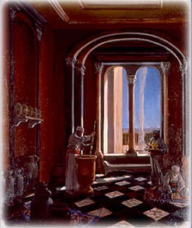
The method, or recipe, for preparing the special incense offering from these ingredients was a closely-guarded secret, passed down from generation to generation within the ranks of one particular family known as Avtinas. In addition to the identity of the spices and the exact amounts and manner in which they are prepared, the clan protected another important secret of their trade: The identity of an herb known in Hebrew as ma'aleh ashan, literally "that which causes smoke to rise." This herb has a quality which enabled the smoke from the incense to rise up to heaven in a straight column. In our own time, some have speculated that this may be the plant Leptadenia pyrotechnica, which contains nitric acid.

Slide 184
Details on the Incense and Incense Fire
The priest who has received the task of offering the incense takes up the special vessels of the incense service: a large golden spoon which holds the amount of 3 kavim, and a smaller vessel, filled to the brim with the incense, and placed inside the larger vessel. This prevented any of the incense from spilling.
The priest who attends to the incense service enters into the Sanctuary, together with one colleague who will assist him. He removes the smaller vessel filled with incense, and hands it to his companion. The latter deposits some of the incense into the palms of the priest.
HAB/WLB 2008 / www.templeinstitute.org

Slide 185
As mentioned before, the incense service only came about once in each priest's life - therefore, the priest who will now officiate has no prior experience. Before he entered, he was warned that he must be very cautious when placing the incense upon the burning coals. If he sprinkles it on the coals too close to the side where he is standing, he will be burned. He is instructed that he must sprinkle it with a motion moving away from himself.
When he receives word from the overseer that he may now begin, the priest begins to let the grains fall from his palms across the top of the altar, slowly, like “one who sifts flour” (Maimonides). When the entire chamber fills with the cloud of smoke, he prostrates himself and exits the Sanctuary.

Slide 186
Details on the Incense and Incense Fire
The choicest branches of fig were singled out and used for the second arrangement on the altar, the one from which fire is taken off and brought to the golden altar, within the sanctuary. Upon this altar the incense will be burnt, and it is the incense service which was the most beloved part of the Temple service to G-d (Zohar I 130:A).
HAB/WLB 2008 / www.templeinstitute.org

Slide 187
Some have written (see Rashi's comments on BT Zevachim 58:A) that it was for this reason the fig branches were specifically chosen for the incense fire - for it was through the fig tree that Adam, the first man, began to make a rectification for his sin, as the Bible states (Gen. 3:7), "... and they sewed fig leaves, and made for themselves loincloths."
Everything in the Holy Temple functioned on many levels; one level is the symbolic. As the incense offering was so special to the Holy One, and helped effect a righting of His relationship with man, it is fitting that such an act comes about through the very element which began that process.

Slide 188
Avtinas Family and the Incense Chamber
The Avtinas family was appointed by the Sanhedrin to provide the incense, and they were exclusively responsible for its production, which was done in the chamber named for them, the Chamber of Avtinas. We have learned that this chamber was located in the south side of the court, over the "water gate.“
HAB/WLB 2008 / www.templeinstitute.org

Slide 189
The Midrash (Shir HaShirim Rabbah, 3:4) provides several poignant glimpses of the Avtinas family, which tell us something of the great dedication that burned in their hearts for their holy occupation: "The Avtinas family were expert in the preparation of the incense spices, and knew how to use the herb ma'aleh ashan, which caused the smoke to rise. But the rabbis were critical that they refused to teach these things to others, and suspended them from office. The sages sent to Alexandria for skilled craftsmen, and engaged these others to try and duplicate the Avtinas' incense. These craftsmen were expert in the spices, but they could not make the smoke rise up in a straight column like the Avtinas family... the smoke from their incense immediately diffused and scattered.

Slide 190
When the sages saw this, they remarked that everything which the Holy One created, He created only for the sake of His own honor, as the verse states (Isaiah 43): 'Every one that is called by My name, for I have created him for my glory; I have formed him, yes, I have made him.' They returned the Avtinas family to their task, and doubled their wages.“

Slide 191
Avtinas Family and the Incense Chamber
"But the wise men asked them: 'What is reason that you do not share secret of your profession; why want to teach others?‘ They responded: 'Our fathers passed on a tradition to us, that one day the Holy Temple will be destroyed. We did not want to teach our secret, so that it does not fall into the wrong hands, the hands of idolators; and one day, the holy incense offering which we presented before the Holy One would then be used for idolatry.' When the rabbis understood that this was the reason for their silence, the Avtinas family was greatly praised.“
"It was also told that no member of their family ever put on perfume. And when one them would marry outside the family, they make an agreement girl should never wear all this so man suspect used secrets holy incense for own personal use, as verse states (Numbers 32), 'And you shall be clean before Elohim Israel'.“
HAB/WLB 2008 / www.templeinstitute.org

Slide 192
"Rabbi Akiva related: Shimon ben Luga told me that once (after the destruction of Holy Temple), he and a young lad - a descendant Avtinas family - were gathering herbs in the fields. 'I noticed that suddenly the boy wept, and then laughed. I asked him, 'my boy, why do you cry?' And he told me, 'For family's honor, which has been diminished.' 'And why did you laugh?', him.
'Because the greatest honor is reserved and established for the righteous in the future world. And in the end result, the Holy One will gladden his descendants, may it be speedily.'“ "I asked the boy, 'what did you see that reminded of all this?' And he told me 'As we were gathering, saw plant ma'aleh ashan before in field.‘
'Show it to me!' I exclaimed. But he told me, 'We have a tradition never to show it to any man.'Only a few days passed, and that child died. Thus he did not reveal it to anyone."

Slide 193
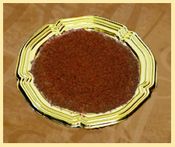
Ingredients and Details on the Incense
The quantity of the ingredients and for the Incense itself is also significant. It corresponds to the amount prepared for one year of daily Temple service. The Torah only lists four ingredients for the Qetoret. The Mishna lists eleven ingredients, in addition to Sodom salt and Karcina lye. The latter text also tells of the Avtinas family and how they were charged with the secret of compounding these precious spices
HAB/WLB 2008 / www.alabaster-box.org

Slide 194
The fragrance of the Qetoret (incense) was said to be so
powerful that that when it was being prepared, one could
smell it as far away as Jericho where the women, it was
also said, did not wear perfume because of the scent.
Jericho was about 12 miles to the north of Qumran.
Curiously, when young Muhammed edh-Dhib, discovered the Dead Sea Scrolls in 1947, only two of the ten clay jars contained anything.
One of the pots held the Scrolls and the other was filled with what was described as a "reddish earth" - a SAMPLE of the Temple incense!
With the discovery of an actual sample hidden away in the Qumran caves no one knew the exact biblical botanicals used.

Slide 195
Ingredients and Details on the Incense
Vendyl Jones examined samples of temple incense found in 1992 dig. An estimated 600 lbs. of what looked like "reddish earth" was uncovered at the North entrance of the Cave of the Column by excavation volunteers in the late Spring of 1992. Team members reported detecting the smell of cinnamon present in the substance. Preliminary analysis by Dr. Marvin Antelman of the Wiezmann Institute revealed that the find was indeed, organic.
"Density indicates that the material which is lighter than water is excluded from the category of red soil or red minerals......also the high percentage of ash is typical of plant source."
Dr. Antelman later told the Jerusalem Post in a story dated May 1, 1992, "I'm very excited about this find … [he] had positively identified borit karshina (karsina lye) which is one of the ingredients spelled out in the Talmud.“
HAB/WLB 2008 / www.alabaster-box.org

Slide 196
Recently, Dr. Terry Hutter performed a more exhaustive analysis and stated that, "the red-brown spice sample is composed of nine different and unique plants. The plants are recognizable both by pollen and organic maceral types."
Dr. Hutter listed these as: Three kinds of Cinnamon, Saffron Balsam, Myrrh, Galbanum, Cassia, and Frankincense.

Slide 197
What Ingredients Make Up The Incense?
Ingredient | Amount | %Comp
1) ha'tzori — balsam | 70 maneh | 13.0%
2) ha'tziporen — onycha | 70 maneh | 13.0%
3) ha'chelbenah — galbanum | 70 maneh | 13.0%
4) ha'levonah — frankincense | 70 maneh | 13.0%
5) mor — myrrh | 16 maneh | 3.0%
6) ketzia — cassia | 16 maneh | 3.0%
7) shibolet nerd — spikenard | 16 maneh | 3.0%
8) kharkom — saffron | 16 maneh | 3.0%
9) ha'kosht — costus | 12 maneh | 2.2%
10) k'lufah — aromatic bark | 3 maneh | 0.6%
11) kinnamon — cinnamon | 9 maneh | 1.7%
A) Borit Karshina — lye | 9 kab | 14.3%
B) Yein Kafrisin — Cypress wine | 3 se'in/3 kabin | 16.8%
C) Melach Sedomit — Sodom salt | 1/4 kab | 0.3%
D) Maaleh Ashan — Smoke producer | kol shehu | 0.1%
E) Kipat HaYarden — Jordan amber | kol shehu | 0.1%
The Eleven Qetoret Spices as listed in the Talmud and Siddur:
HAB/WLB 2008 / www.alabaster-box.org

Slide 198
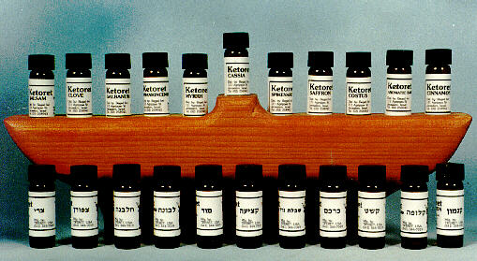
Balsam Cassia Cinnamon Cinnamon Bark Costus Frankincense Galbanum Myrrh Onycha (Clove) Saffron Spikenard
Nine of the Eleven Temple Spices in their raw unprocessed form.

Slide 199
Onycha
Anti-inflammatory
Antiseptic
Antioxidant
Astringent
Deodorant
Diuretic
Expectorant
Sedative

Slide 200
spikenard
Anti-bacterial
Anti-fungal
Anti-inflammatory
Deodorant
Relaxing
Skin tonic

Slide 201
Myrrh
Properties of healing
Anti-infectious, anti-inflammatory, antiseptic, astringent and tonic

Slide 202
balsam
Properties
Antiseptic (fenito-uninary, pulmonary)
Astringent
Diuretic
Expectorant
Sedative
Tonic

Slide 203
saffron
It has been recognized of value as an
antispasmodic
diaphoretic
carminative
emmenagogic
sedative.

Slide 204
cassia
Properties
Anti-bacterial
Anti-fungal
Anti-viral

Slide 205
Galbanum
is an earthy aroma used in ancient temple ritual anointings and is used to support the immune, digestive, respiratory, circulatory and other systems of the body

Slide 206
Frankincense
(Boswellia carteri)
sweet, warm, balsamic aroma stimulating and elevating for the mind. Frankincense has been used in religious annointings and ceremonies for millenia, and is currently being scrutinized and tested for its anti-cancerous and anti-tumoral properties.

Slide 207
cinnamon
Anti-bacterial (98% pathogenic bacteria)
Antidepressant
Anti-fungal
Anti-infectious (intestinal, urinary)
Anti-inflammatory
Antimicrobial
Antioxidant
Anti-parasitic
Antiseptic
Antispasmodic
Anti-viral
Immune stimulant
Purifier

Slide 208
Incense Route and Prophetic Significance
In looking at history of incense and the spice routes, the fascinating part is that the majority of biblical scents mentioned were imported from countries as far away as China and as close as Lebanon. Elohim not only chose to import these spices from foreign lands but also chose to plant them in these lands. Elohim fully knowing at a particular point in the history of Israel He would gather these spices to present this sweet smelling oblation to Himself through the Levitical priests.
HAB/WLB 2008 / www.alabaster-box.org

Slide 209
Seeing that these spices represent a prophetic declaration both unto YHVH and for YHVH, and this gathering of spices from other nations and most often through Egypt, speaks to us of Elohim's intention to gather the nations unto Himself in Yahshua. As an offering or sweet smelling sacrifice of prayer that has entered into the Messiah’s sufferings of intercession for a lost and dying world. The Incense and service actually spoke of and reflected Yahshua and His ministry to His Father, Yahweh, while on earth.
There is also great significance in the fact that the herbs, resins, and spices used for worship, not having their origin in Israel, speaks of Elohim's intentions to draw out of the nations a people for Himself. Israel was not to be alone in the service of worship and prayer ministering to Elohim. Eventually the invitation to all who would willingly come would be issued and we the gentile nations would respond and there by receive the free gift of salvation.

